Slide 1

Interview Meeting
Presented by Sara Bolouri Bazaz

Slide 2
I am going to talk about …
Introduction
Background and Interests
Motivation
Dissertation
Question Answering

Slide 3
Introduction

Slide 4

I am …
Sara Bolouri Bazaz
Bachelor
Computer Engineering
Ferdowsi University of Mashhad (FUM)
16.77 out of 20.00 (3.37/4.00)
Thesis -> Implementing a part of the back-end of a content management system
Master
Software Engineering
Ferdowsi University of Mashhad (FUM) - Direct Acceptance
19.15 out of 20.00 (4.0/4.0) – Ranked Second Among all entry students in school of Computer Engineering
Thesis -> Analyzing, designing, and developing the website of the supply chain, and the global logistic network — Blockchain part
Notes:
First of all I want to introduce myself. My name is Sarah Bolouri Bazaz. you can call me Sara. I am 24 and I am married. My husband is a phd student at UoT and he is Canada right now. So we are far from each other.
I have been studying for around 6 years in computer field at Ferdowsi University of Mashhad (FUM). 4 year of this 6 year I was bachelor student in computer Engineering. My total GPA was 16.77 and I finished my bachelor program by developing a part of the back-end of a CMS. immediately after that, I got direct acceptance at FUM and got invited to continue my education as master student. My total GPA up to now is 19.15 out of 20. My thesis subject is … which I will discuss in further.

Slide 5


My background and
Interests are …
My Motivation is …
Software Programing (Developing many course projects)
Software Analysis and Design (TA for 7 semesters)
Blockchain Technology (used in thesis)
Web Programing
Software security
Smart Contract
Gaining experience by studying abroad
Blockchain Technology is more developed in Canada than Iran
Most better projects are launched in Canada than Iran
Can find better job positions not only in Canada but also in Iran
Notes:
In this slide I want to talk about my background and motivation. First of all to mention my background I can say that software programing, software analysis and design, and blockchain are some area are my interest research. Moreover I would like to continue my education not only on my background but also on other fields such as web programing, software security and smart contracts.
Also, I want to talk about my motivation to continue my education in Canada. Firstly, by studying abroad I can gain a great experience in an international environment, which helps me to expand my social network in computer area. Secondly, Since more blockchain-based projects are launched in Canada in comparing with Iran, Blockchain Technology is progressed in Canada quickly. Therefore, studying in Canada can help me to improve my skills in blockchain technology. Finally, If I get my Ph.D. degree from one of university of Canada, I will be able to find better job position in not only in Canada but also in Iran.

Slide 6
My Current Work

Slide 7

Dissertation …
About Project:
International Freight and logistics services community
Its concept was created by a team in SQL
Named Cayload (The address is https://sinax.info/)
Concluding contracts with high level of importance
The Problem:
Misusing of contracts
Committing financial frauds by either parties (provider or customer)
Changing contract content by either users according to their own benefits
The Solution:
Using blockchain Technology to save sensitive data
Notes:
Before explaining my dissertation, I want to talk about the project which I developed a software for it as my dissertation.
This project is a platform, named cayload, for International freight and logistics services community. Its concept was created by a team at SQL which is under supervision of my supervisor, Dr. Rassolzadegan. In this platform, users can conclude contracts with each other on whatever services they want.
Next, I want to talk about the problem which this project faces to. Since the concluded contracts are with a high level of importance, misusing of contracts can be happened by committing financial frauds with either providers or customers. Moreover, each user can change the contract content according to his own benefits.
To solve this problem, I came up with a blockchain-based solution to save these sensitive data. Developing of this solution is defined as my dissertation.

Slide 8
Dissertation …
Project-based thesis
Two different approaches were developed for proposal
First one: developing blockchain by myself (It has a problems)
Second one: using Hyperledger Fabric Framework
Developing a comprehensive software (in progress)
used second approach in a manner of using by all sites
Notes:
Now, I want to explain my dissertation. First of all, it is project-based thesis. At first, there was developed two approaches to save important data by using blockchain Technology. The first one had some problems. Therefore, I developed the second one to enhance it. In the first one, there was developed all blockchain process by a developer, while in the second one I used Hyperledger Fabric to process blockchain operations automatically.
To finish my dissertation, I have to expand the second approach to a comprehensive software which most sites to be able to use. Right now, this software is in progress and I hope to finish it in two months.
In the two next slides, I will explain more about these two approaches and the comprehensive software.

Slide 9
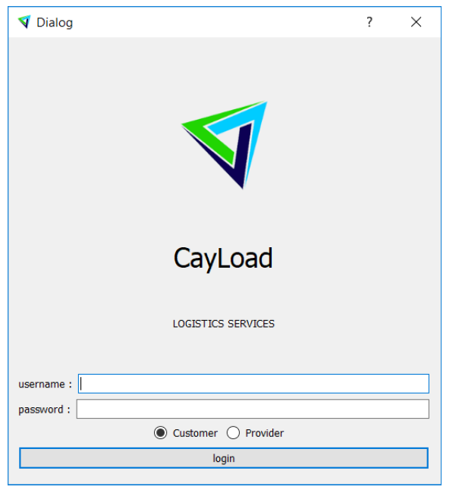
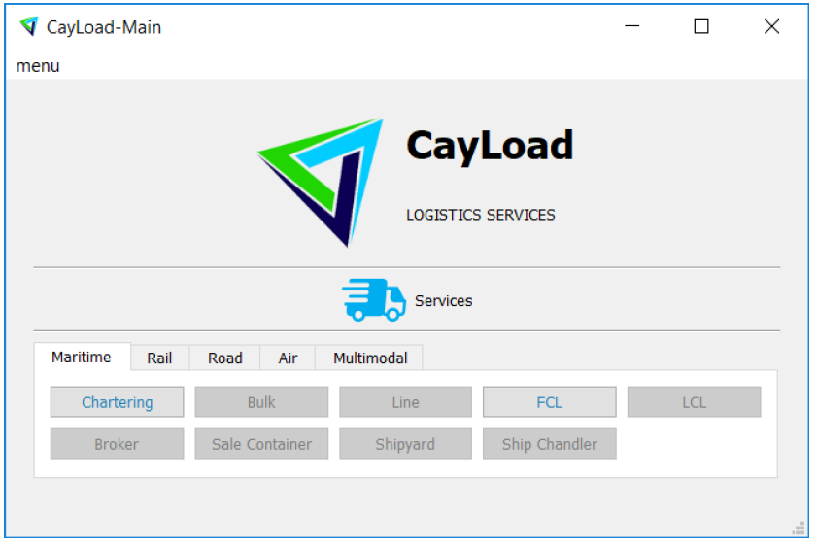
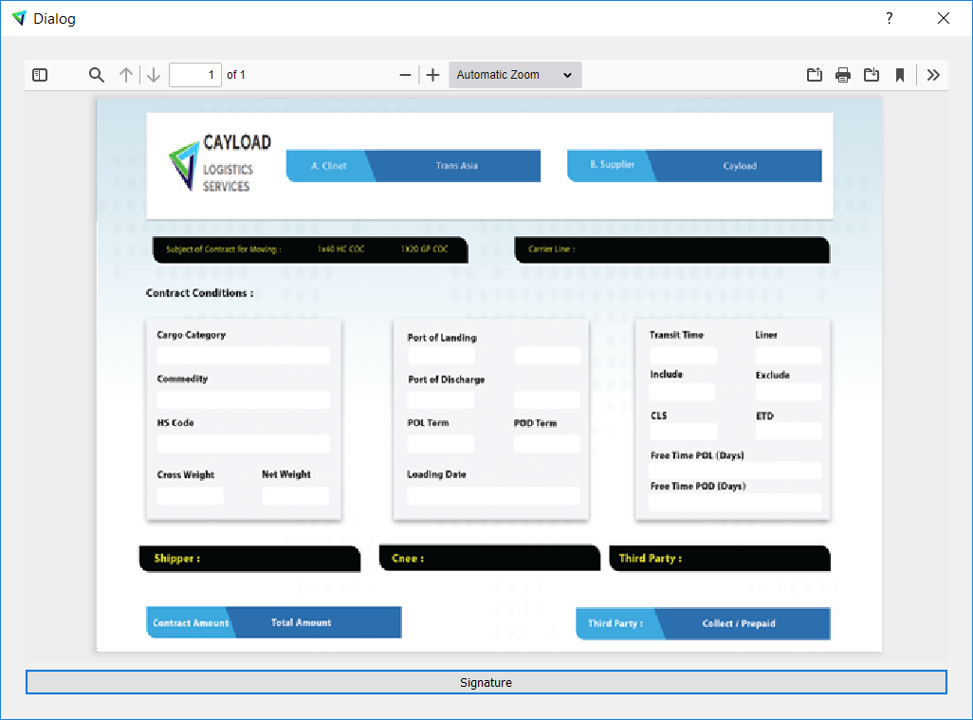
Dissertation … First Approach
Dissertation … Second Approach
This approach is developed for two services, FCL and Chartering.
Proof-of-Work, used in Bitcoin, is developed.
Each contract stores in a separate chain.
The chain stores in our server and both users’ systems.
Each user has a pair of private and public keys (RSA library is used).
Each contract is signed by users.
This approach is developed for one service, Air.
Hyperledger Fabric Framework is used.
All contracts store in one chain.
The chain store in several servers.
Each user has a pair of private and public keys (RSA library is used).
Each contract is signed by users.
Notes:
The first approach was developed for two services, named FCL and Chartering. In this approach, each contract has its own chain. In other words, there is one chain per contract. Each chain stores in server and both users’ system which helps to resist to single point of failure. Each user has a pair of private and public keys, which are used for signing the contract. When a contract is signed by a user, one block is created and mined by Proof-of-Work algorithm. Then the mined block is added to its chain. However, this approach has a security problem. Because each chain at most has 3 blocks (one genesis and two blocks according to user signature). Therefore it is easy for a user to make a new chain according to his benefits.
To enhance the security, The second approach is developed for one services, named Air. In this approach, Hyperledger Fabric Framework is used. Therefore, all contracts store in a one chain and the chain is stored in several servers. Like the previous approach, each user has a pair of private and public keys, which is used by user for signing the contract.

Slide 10
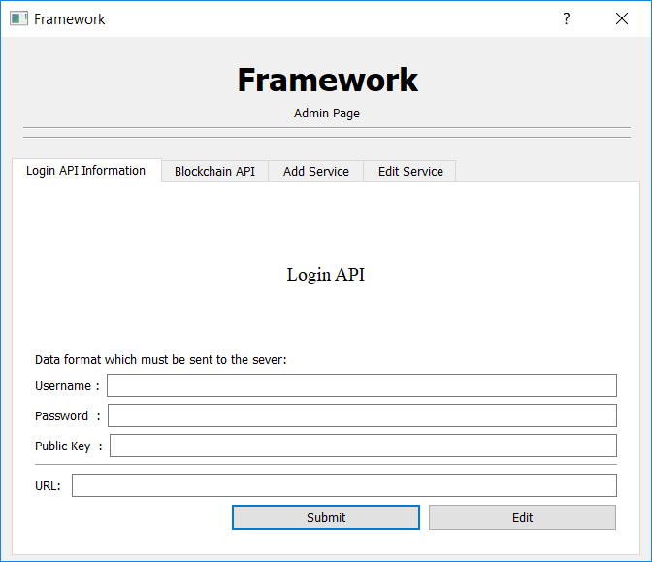
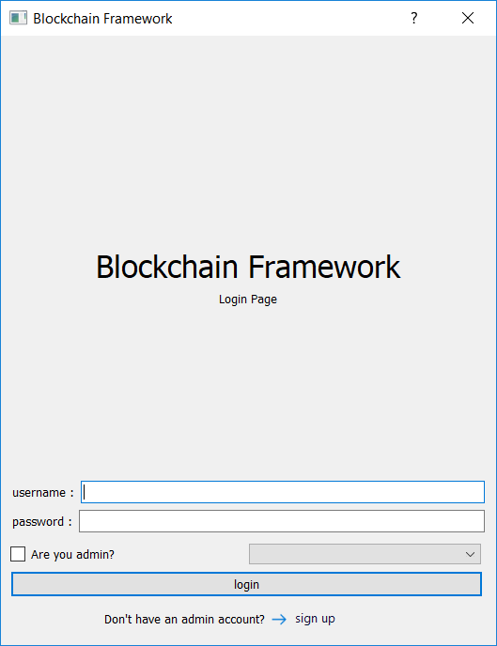
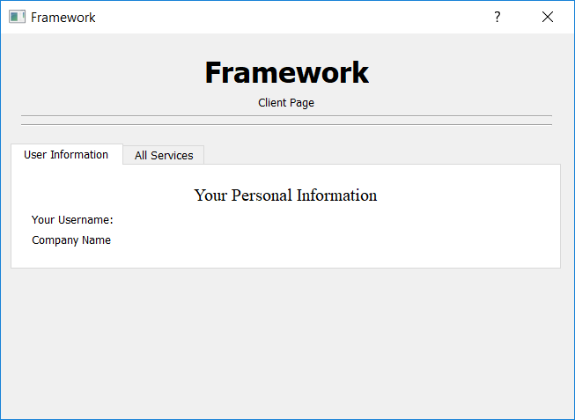
Dissertation … Comprehensive Software
Admin Page Interface
Login Interface
Second approach is expanded.
Each site must sign-up .
Each site has admin.
Site’s information store in a server.
Client Page Interface
Notes:
After the second approach was developed, to finish my dissertation I need to develop a comprehensive software that most sites to be able to use for saving their data. For this software, I need to have some information about the site. Therefore, each site, willing to use the software, must be signed up by its admin. Then the admin complete the information that the software needs. After completing information, the end-users of site are able to use the software to sign their contract and store in blockchain.

Slide 11

Question Answering
Thanks for your attention

